Slide 1
Teaming AGREEMENTS & Risk Management
DR. M ASGHAR MUGHAL
Lecture 4

Slide 2
Strategic Alliance
Strategic Alliance means establishing a relationship between two or more contractors for multiple opportunities. Strategic Alliance establishes the relationship between companies for multiple opportunities. A strategic alliance may result in many teaming agreements. Formation usually progresses in stages similar to these:
1. Networking & Target Opportunities Identification
2. Strategy Development
3. Partner Assessment
4. Agreed Assignment of Roles & Responsibilities
5. Contract Negotiation
6. Alliances in Operation
7. Termination of Alliances

Slide 3
Why Form Alliances?
Teaming agreements between one company and another means that two or more companies will join forces to go after a new segment of work, often a particular new project.
Each company will commit something unique to their arrangement:
  Financial Resources
  Human Resource
  Company Assets
  Technology
  Risk/Reward Sharing

Slide 4
Alliance vs partnership
An alliance is a collaboration between individual companies for mutual profit, while a partnership is a merging of individual interests for mutual profit.

Slide 5

Teaming Agreements
Teaming agreements between one company and another means that two or more companies will join forces to go after a new segment
Teaming Agreements in general happen when parties enter into arrangement in which:
  Two or more companies form a partnership or joint venture to act as a potential prime contractor; or
  A potential prime contractor agrees with one or more other companies to have them act as its subcontractors under a specified commercial or government contract or acquisition program. Or
  An agreement for a joint proposal resulting from a normal prime contractor-subcontractor, licensee-licensor, or leader-company relationship

Slide 6
Forms of Teaming Agreements/Alliances

Slide 7
Forms of Teaming Agreements/Alliances
  Joint venture
    A registered legal entity
    Sharing of not just resources but also profits, losses, liabilities and even equity
    Useful to secure large finances
  Partnership/Consortium
    Not necessarily a registered legal entity
    Limited to sharing of resources with the tasks clearly defined for each partnering firm
    Each participating firm is liable to justify only its part of the job
    Sharing technology, trademarks or other assets
  Typical Informal Types:
    Prime contractor-subcontractor relationship
    Licensee-licensor relationship
    Leader-follower company relationship
    Any other type of relationship as defined and intended by the parties to the agreement.

Slide 8
What is the relationship between the contractor and the subcontractors?
For example, a building contractor may hire a subcontractor to complete the electrical wiring part of the contractor's building job. The contractor is responsible to the client for the building job including the part performed by the subcontractor.

Slide 9
    Licensee-licensor relationship
The licensee is the party that receives a license, while the licensor is the party that grants the license. For instance, when a car owner gets a driving license from the state where he can drives his car, the owner is the licensee and the government that issued the license is the licensor.

Slide 10
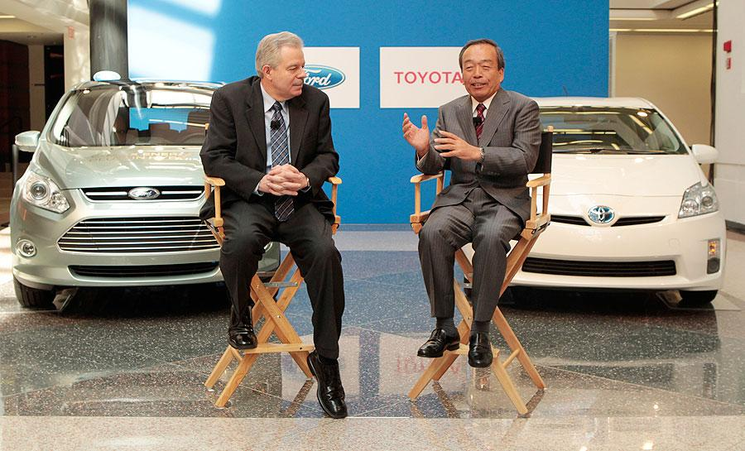

Joint Ventures
An enterprise owned and operated by two or more businesses or individuals as a separate entity (not a subsidiary) for the mutual benefit of the members of the group.
Joint ventures possess the characteristics of joint control; e.g. joint property, joint liability for losses and expenses, and joint participation in profits.
Joint ventures can be either incorporated or unincorporated.
Ford and Toyota:
“Partnership to develop gasoline-electric systems for pickups and SUVs”

Slide 11



Consortiums/Strategic Alliances
In July 2011, Facebook announced a strategic alliance with Skype, which had been recently acquired by Microsoft. This allowed Microsoft to quickly move into the social networking space, Skype received access to a large number of new users and Facebook could leverage Skype's technology to enable video chat without making the investment in building it.
By contrast, Dow Chemical formed a joint venture with Japanese firm Ube to create a factory for a particular high-tech battery. They shared technology and risk of new product development.

Slide 12
Models of Teaming Agreements/Alliances

Slide 13
Models of Teaming Agreements
Teaming with a Superior-Subordinate Relationship (Vertical Hierarchy)
Teaming agreements creating "partners.“ (Horizontal Linkage)
Performance on a single project but "without" a teaming agreement

Slide 14
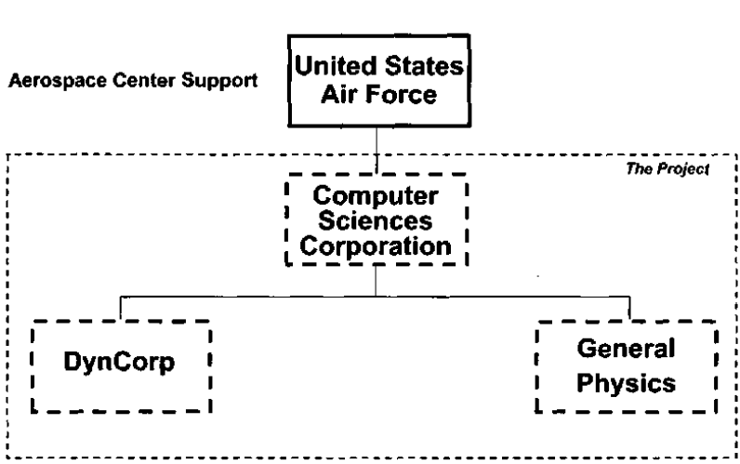
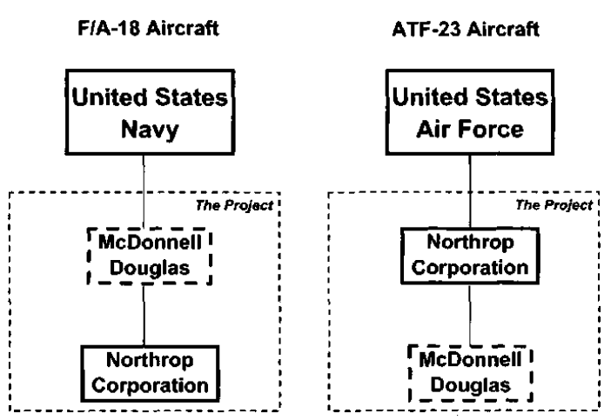
Model #1: Teaming with a Superior-Subordinate Relationship
All parties to the agreement, including the buying customer and the two subcontractors, know precisely who is responsible for the project
Even though the roles are clearly defined, the superior partner might over charge the client for managing the subordinate.

Slide 15
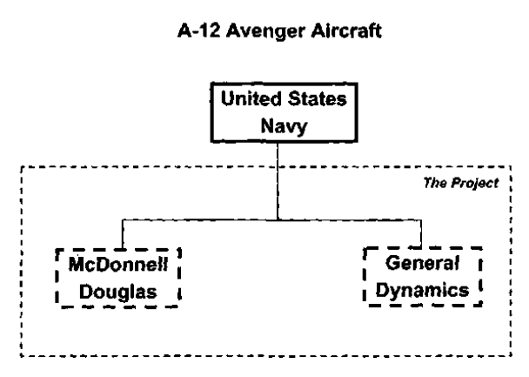
Model #2: Teaming agreements creating “Partners”
A single contract will be issued by a customer to either a joint venture, or directly to each of the various firms participating in the arrangement.
Each firm was expected to perform 50% of the project scope in accordance with their previously defined teaming agreement

Slide 16
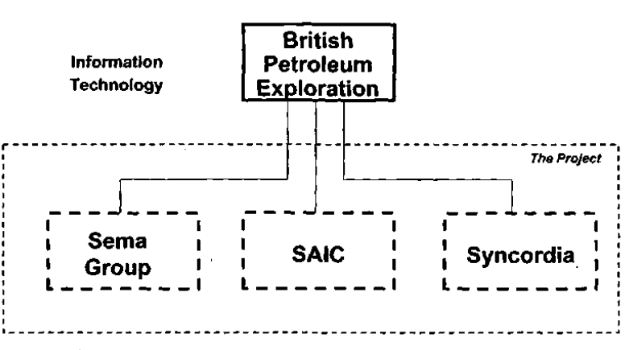
Model #3: Performance on a single project but "without" a teaming agreement
No teaming arrangement covering the multi-company performance on a single project.
Buyer simply expects that the chosen companies will work together in a cooperative, harmonious way, under their direction.
BPX awarded three separate contracts to the selected companies, the details of each contract were known only to BPX and each respective company.
The stated intent of BPX was to let the three contracted companies work out their own detailed interfaces, and to minimize the BPX management responsibilities
Should this arrangement have worked?

Slide 17
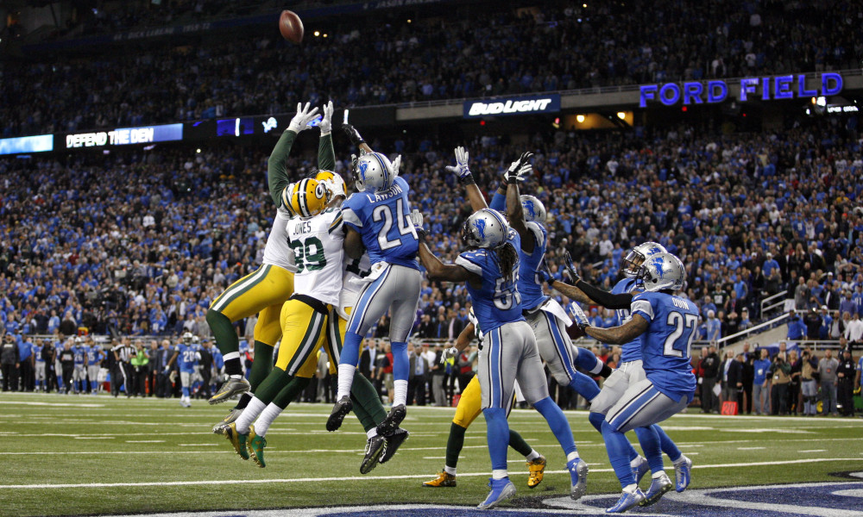
Answer!: “Hail Mary Pass”
“The contracts were drawn up in ways that did not encourage cooperation between vendors. This left BPX a range of inter-contract problems arising from what was described as 'the cracks‘ between vendors. BPX ended up with the considerable task of having to manage not only each individual sub-contactor but also the relationship and interfaces between them”
(1) Sheer desperation,
(2) No definitive plan of action.

Slide 18
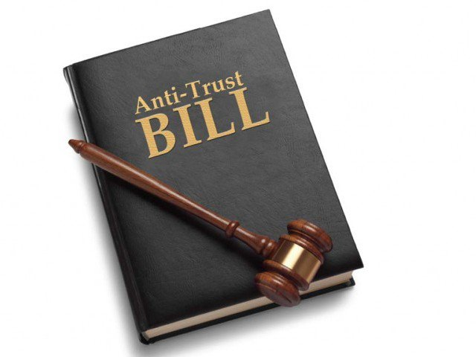
Cracking Down on Cartels: Anti Trust Law!
Free market and fierce Competition is beneficial for the public; alliances are not!
Trust: An association or organization of persons or corporations having the intention and power, or the tendency, to create a monopoly, control production, interfere with the free course of trade or transportation, or to fix and regulate the supply and the price of commodities.
The "trust“ was originally a device by which several corporations engaged in the same general line of business might combine for their mutual advantage, in the direction of eliminating destructive competition, controlling the output of their commodity, and regulating and maintaining its price, but at the same time, preserving their separate individual existence, without any consolidation or merger”

Slide 19
Anti –Trust Law in Pakistan
The Competition Act of 2010 was signed by the then President Asif Ali Zardari of Pakistan. The anti-trust bill was singed for cracking down on business cartels, formalizing it as an act of the parliament.
The endorsement of the Competition Act of 2010 is suppose to provide legal cover to the Competition Commission of Pakistan (CCP), the legal existence of which had ceased after the lapse of the CCP ordinance.

